Slide 1
Category review: Chips
March 2024
Retail Analytics
Brand note: If client logo is not required, use alternate title page layout right click slide thumbnail > Layout > Title

Slide 2
Notes:
To view Privacy video explaining how important data privacy is to Quantium, please click here: https://www.youtube.com/watch?v=Zq1QDAkoRzU
or here Q:\Company Reference\Brand & Design\Brand videos\Q Privacy.mp4
At Quantium, we believe that data is the behavioural footprint of humanity and that it has to be treated with the utmost care and responsibility.
Histories, attitudes, indeed lives are stored within it in ways that aren’t always apparent – and that’s what makes its potential so powerful.
To work with it responsibly, sensitively, we set ourselves the highest data privacy protection and governance standards.
We have spent 17 years perfecting privacy-by-design and secure-by-design principles. Central to this is not holding any personally identifiable information about people –
we neither receive it, and put the necessary protections in place to be unable to decipher it.
Every aspect of handling data is safeguarded: from its de-identification, to its encryption – data security is paramount and of the highest grade.
We pride ourselves on gaining the trust of iconic organisations around the world through years of securely working with their data,
and in turn the trust that builds with their stakeholders.

Slide 3
Executive summary
01
Chips Category Review
There is an increase in sales in the lead-up to Christmas, and there are zero sales on Christmas Day. This is due to shops being closed on Christmas day.
Mainstream young singles/couples are 23% more likely to purchase Tyrrells chips and 56% less likely to buy Burger Rings than the rest.
Sales are coming mainly from Mainstream - young singles/couples and Mainstream – retirees. There is more opportunity for sales with these shoppers.
02
Trial Store Analysis
A control store was established to mirror the prior performance of the trial store.
Upon implementation, a comparative analysis revealed a statistically significant increase in performance for the trial store.

Slide 4
01
Category

Slide 5

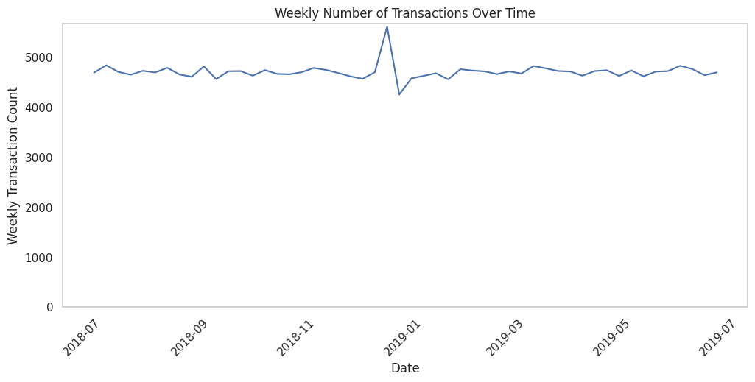
The number of Chips transitions has remained relatively consistent over the last 52wks; a notable increase occurred in the week leading up to Christmas
The total number of
transactions in the week
including Christmas was
negatively affected by public
holiday store closures

Slide 6

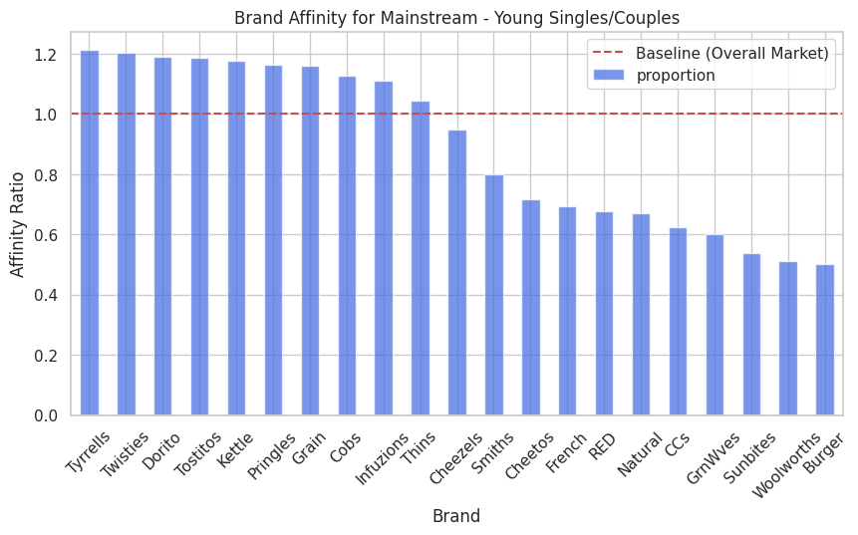
Affluent Mainstream Young Singles & Couples Show Stronger Brand Affinity for Tyrrells Compared to Other Brands

Slide 7
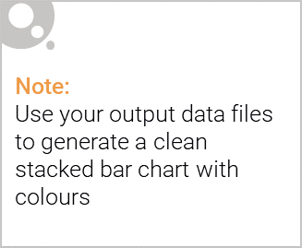
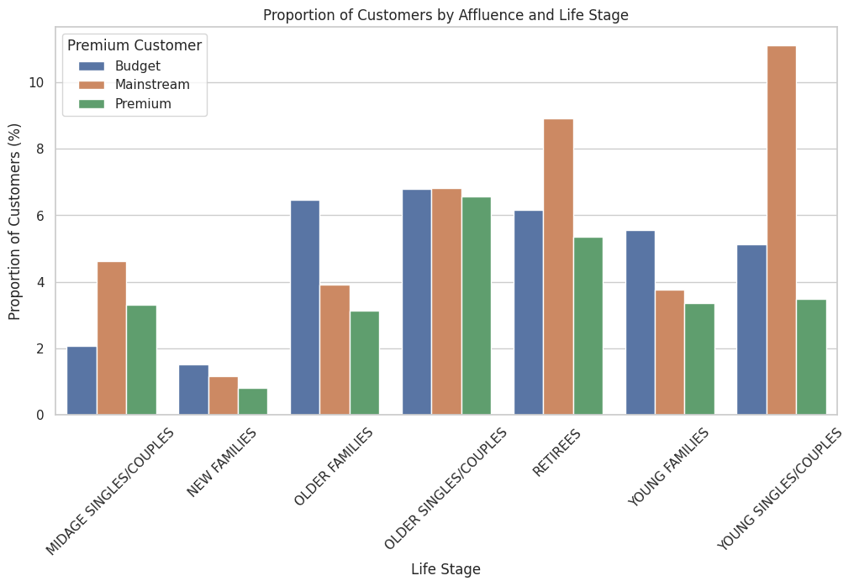
Editable (delete this)
Mainstream Young Singles & Couples and Mainstream Retirees Drive the Majority of Sales Based Affluence and Life Stage

Slide 8
02
Trial store performance

Slide 9
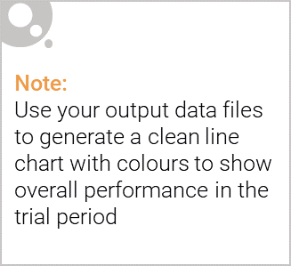
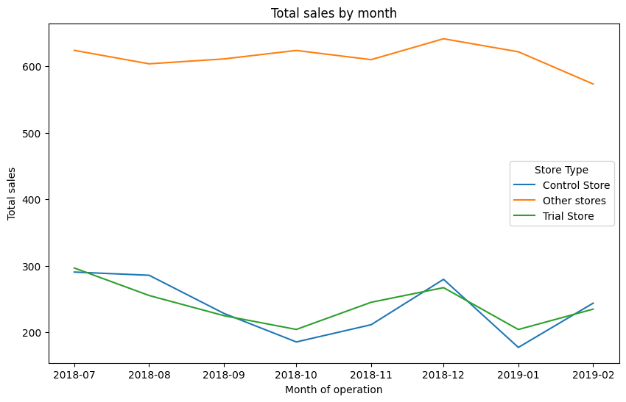
A control store was to mirror the performance of the trial store, rather than using an average across other stores.
Average Monthly Sales Over Time

Slide 10
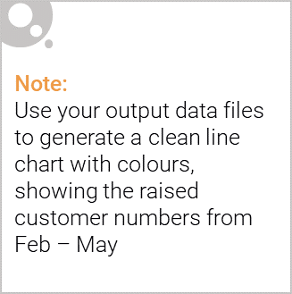
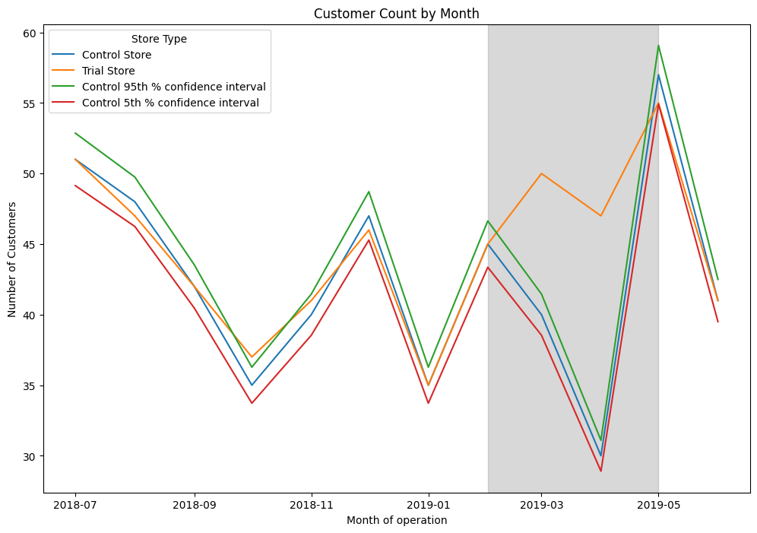
The new store layout proved successful, with the trial store significantly exceeding the control store's performance from February to May
Number of customers Over Time

